Slide 1
Digital Portfolio
STUDENT NAME: RUPAK KUMAR V
REGISTER NO AND NMID: DEB79BC7A71BD6DADB34FD3DE280906F
DEPARTMENT: BCA
COLLEGE/ UNIVERSITY:AGURCHAND MANMULL JAIN COLLEGE
University of Madras

Slide 2
PROJECT TITLE
INTREACTIVE DIGITAL PORTFOLIO USING FRONT END DEVELOPMENT

Slide 3


AGENDA
Problem Statement
Project Overview
End Users
Tools and Technologies
Portfolio design and Layout
Features and Functionality
Results and Screenshots
Conclusion
Github Link
3/21/2024 Annual Review

Slide 4

PROBLEM STATEMENT
LACK OF PROFESSIONAL WAY TO SHOW THERIR RESUMES THEIR QULIFICATION,CERTIFICATES AND ETC.,.

Slide 5

PROJECT OVERVIEW
This project contains personal portfolio which contains details of student like their , skills , contact and etc.,.

Slide 6

WHO ARE THE END USERS?
Clients , hiring managers , faculty , general peoples , HR’s , general peoples and professional networkers likes LinkedIn and etc.,.

Slide 7

TOOLS AND TECHNIQUES
TOOL’s:
VS CODE(visual studio)
CODEPEN
BROWSER(chrome)
TECHNIQUES:
HTML(to structure the code)
CSS(to give it style)
JAVA SCRIPT(Creating a Dynamic Page)and etc.,.

Slide 8
POTFOLIO DESIGN AND LAYOUT
Clean and modern Ul
Navigation bar with smooth access
Sections: About, Skills, Contact
Responsive grid layout for skills and etc.,.
8

Slide 9
FEATURES AND FUNCTIONALITY
FEATURES:
HOME SECTION
ABOUT ME
SKILLS
CONTACT
FUNCTIONALITY:
NAVIGATION BAR
INTERACTIVE ELEMENTS-(BUTTONS,HOVER EFFECTS)
SOCIAL MEDIA AND ETC.,.

Slide 10
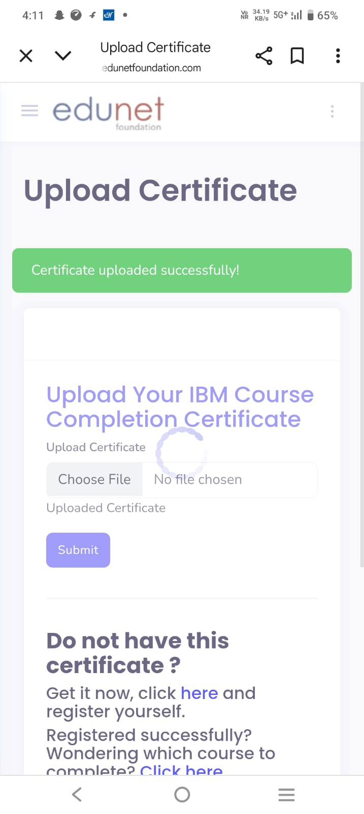
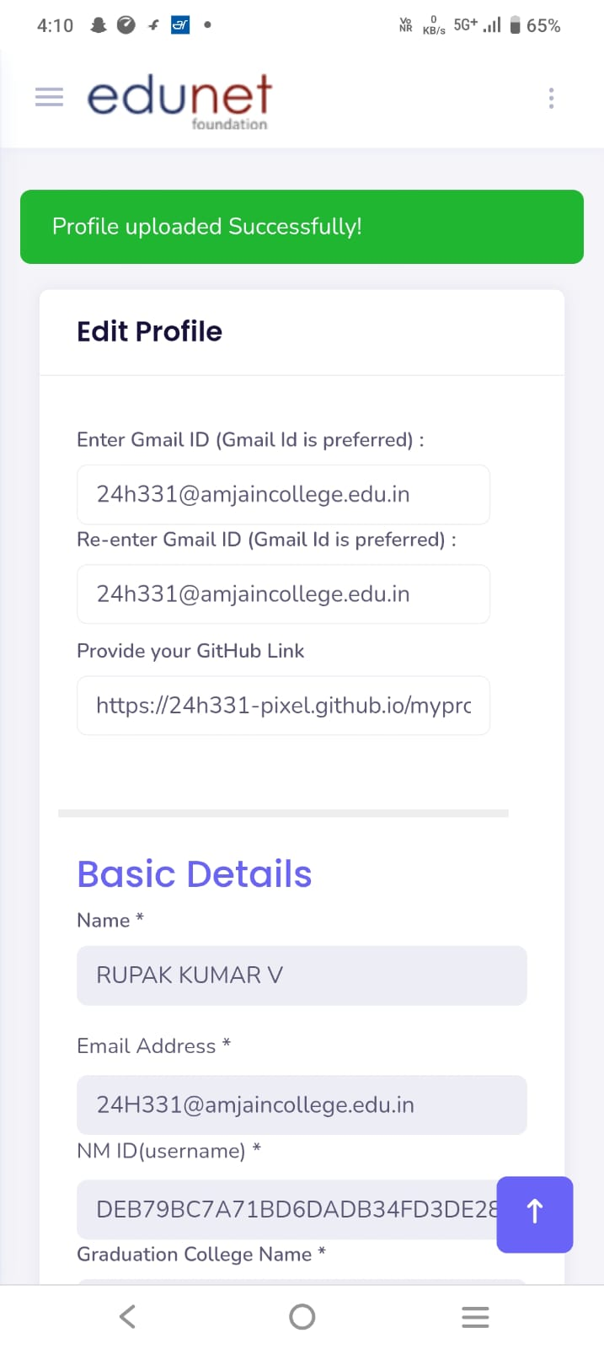
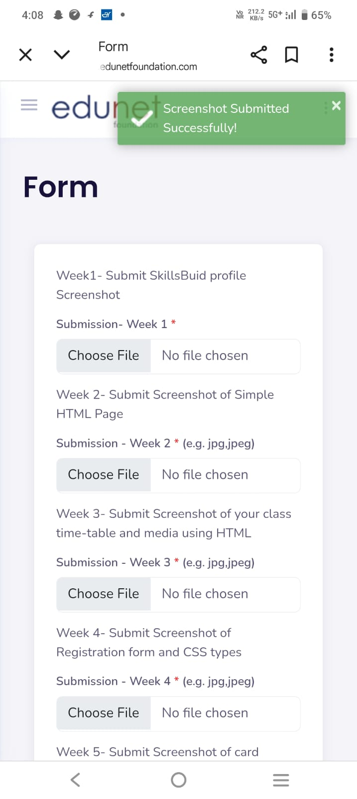

RESULTS AND SCREENSHOTS
3/21/2024 Annual Review
10

Slide 11
CONCLUSION
This portfolio showcases my skills, certifications, and achievements as a student. I am eager to keep learning, improving, and applying my knowledge to future opportunities
11

Slide 12
GITHUB LINK
PROJECT LINK:
GITHUB SERVER LINK:
https://24h331-pixel.github.io/myproject/

